Slide 1

Unlocking Insights: Order Tracking And Status
Annual reports hold a treasure trove of business insights.
However, raw data can be messy and difficult to analyze.
This presentation will guide you through cleaning store annual report data effectively in Excel.
By: Yogesh (22BCA10600)

Slide 2
The Power of Clean Data
Clean data is essential for accurate analysis and decision-making.
Dirty data leads to flawed conclusions and missed opportunities.
Reduces errors and biases.
Inaccurate financial forecasts.
Enhances the reliability of reports.
Ineffective marketing campaigns.
Improves the efficiency of data processing.
Poor operational strategies.

Slide 3
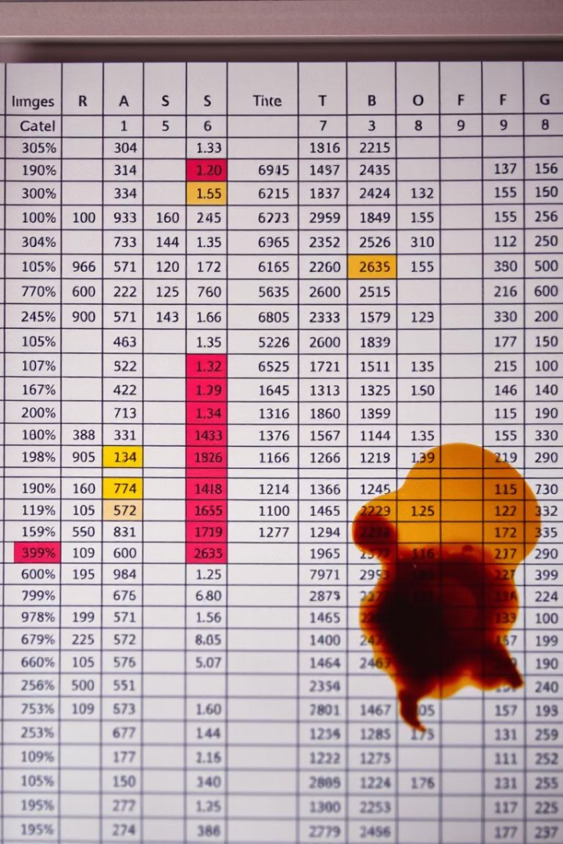




Navigating Common Data Challenges
Inconsistent Formatting
Different date formats or number styles across entries.
Missing Values
Blank cells or incomplete records.
Duplicate Entries
Repeated data points that skew analysis.
Typographical Errors
Misspellings and incorrect entries.

Slide 4





Strategies for Sparkling Data
Standardize Formatting
Apply consistent formats to dates, numbers, and text.
Replace Missing Values
Use appropriate values or indicators for missing data.
Remove Duplicates
Identify and eliminate duplicate entries.
Correct Errors
Manually review and correct typographical errors.

Slide 5

Excel's Cleaning Toolkit
Text Functions
Date Functions
LEFT, RIGHT, MID, TRIM, SUBSTITUTE for text manipulation.
DATE, YEAR, MONTH, DAY for date formatting.
Lookup Functions
VLOOKUP, HLOOKUP for data validation and matching.

Slide 6




Addressing Gaps and Inconsistencies
Impute Values
Identify Missing Data
1
Replace with averages or median values.
Use formulas like ISBLANK to find gaps.
2
Document Decisions
4
Flag Inconsistencies
Record imputation methods for transparency.
3
Use conditional formatting to highlight errors.

Slide 7

Streamlining the Cleaning Process
Record Macros
Automate repetitive tasks.
Use Power Query
Transform data from multiple sources.
Create Templates
Standardize cleaning procedures.

Slide 8

Protecting Data Integrity
1
2
Data Validation
Audit Trails
Restrict input to valid values.
Track changes and modifications.
3
Regular Backups
Protect against data loss.

Slide 9
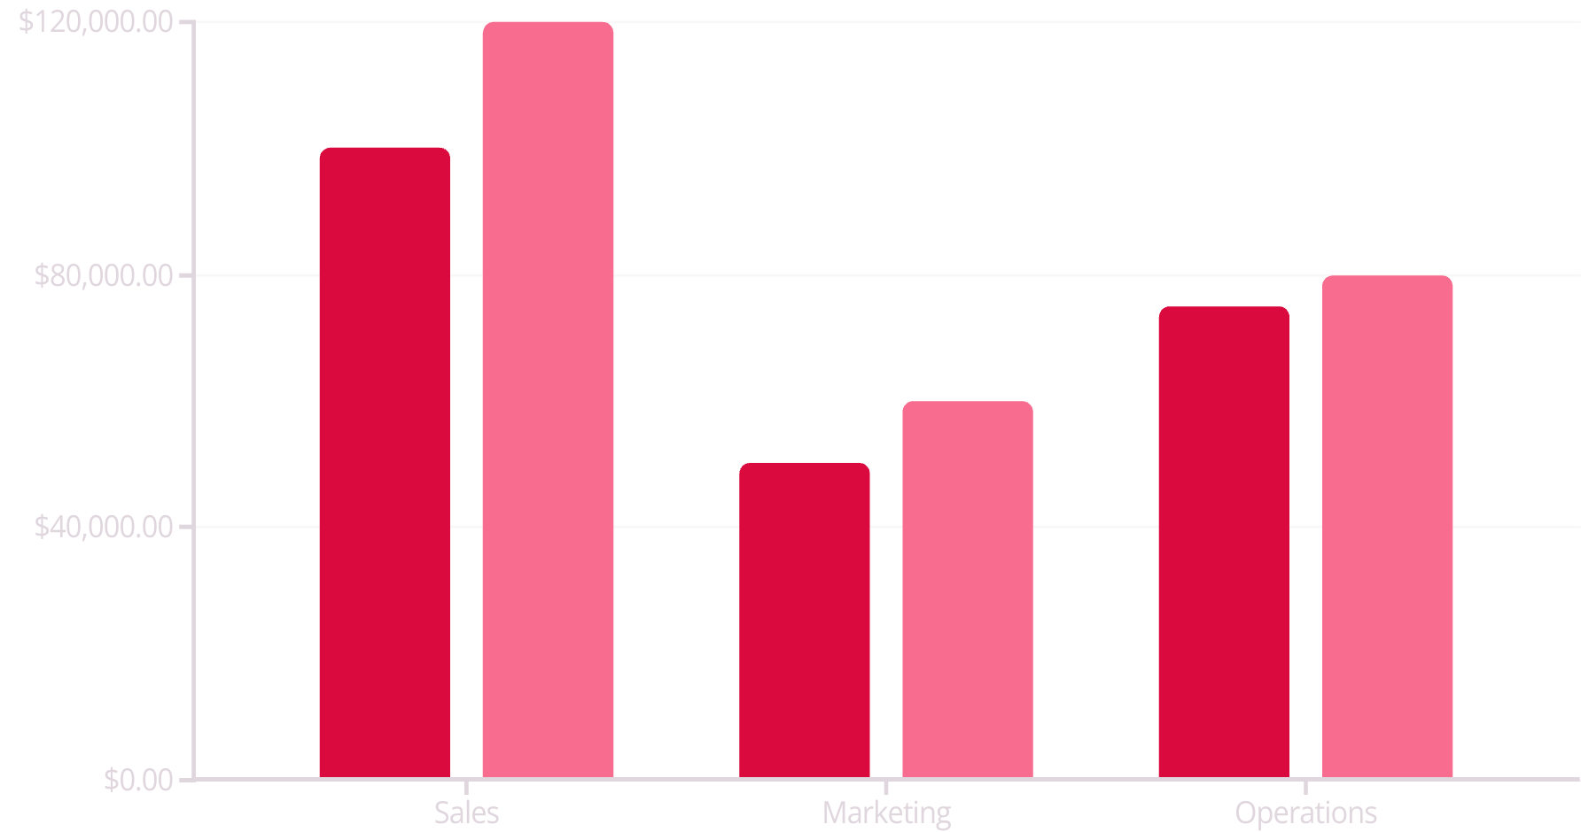
Visualizing Clean Insights
2022
2023
Clean data enables powerful visualizations.
Use charts and graphs to communicate insights effectively.

